Slide 1


Data Science
Prepared by
Sudip Samanta
Assistant Professor
Brainware University

Slide 2
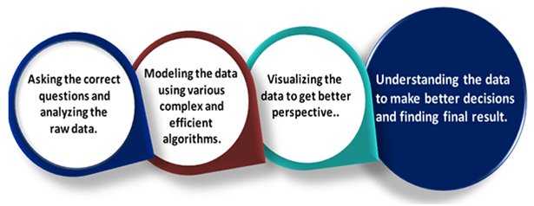
Introduction to Data Science

Slide 3
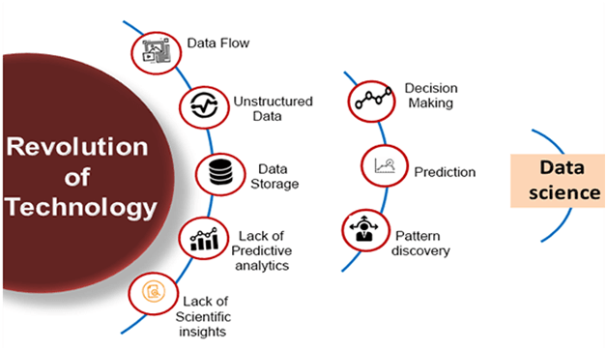
Evalution of Data Science

Slide 4
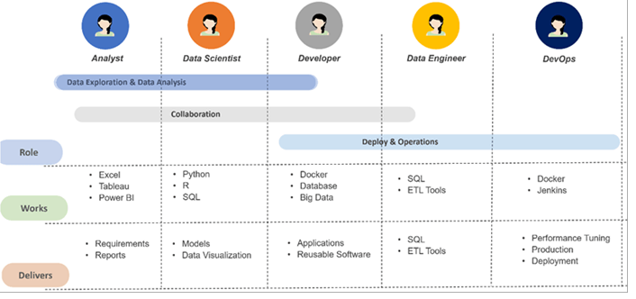
Data Science Roles

Slide 5
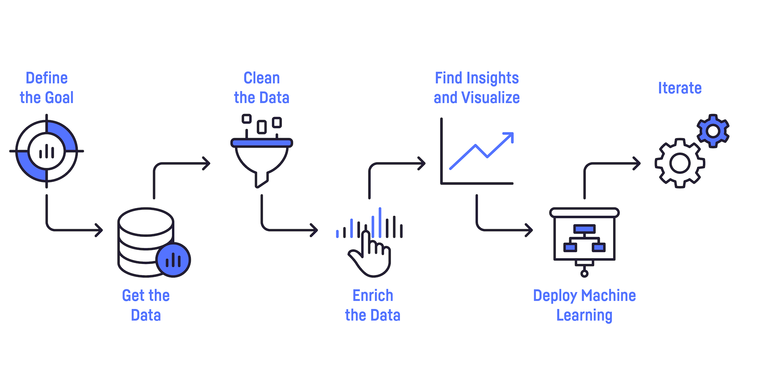
Stages in Data Science Projects

Slide 6
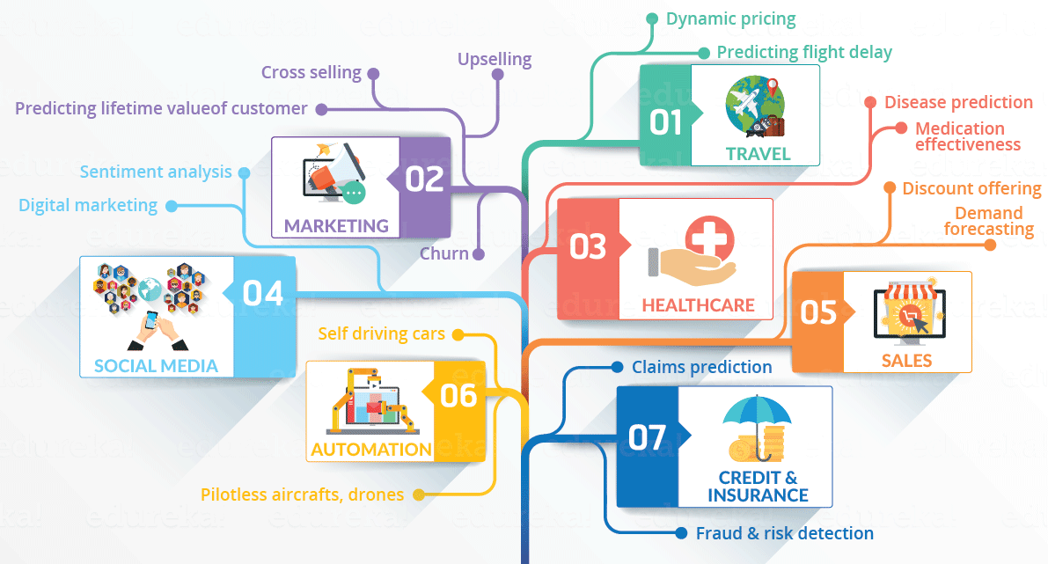
Application of Data Science in Various Field

Slide 7
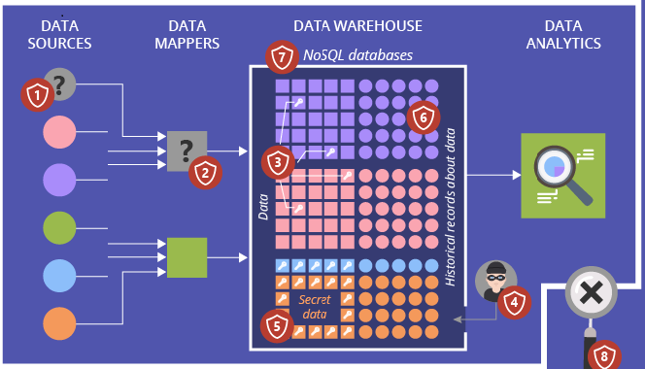
Data Security issues

